Slide 1
Solid Principle
Natnael Tsige
Nicholas Scofield
Muluh Clive Muluh

Slide 2

Solid Principle
SOLID principles are a set of object-oriented design principles collected by American computer scantiest Robert C. Martin (aka uncle Bob) in 1995.
Martin has written many book.
Recommendation
“Design principles and patterns”(2000)

Slide 3
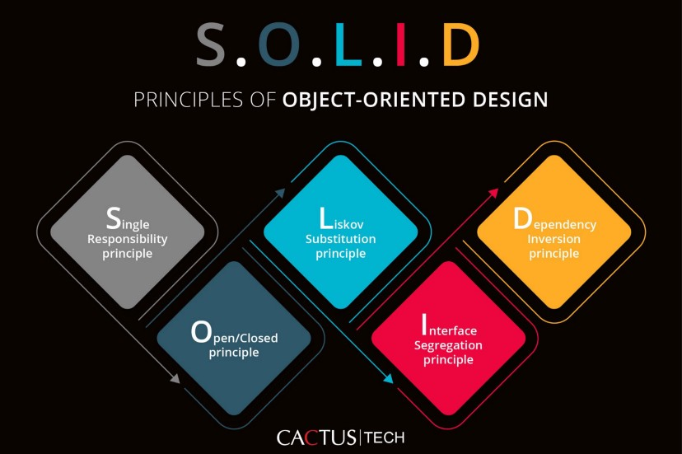
What is Solid principle?
The SOLID Principles are five principles of Object-Oriented class design.
SOLID is an acronym for the following five principles.
S - Single responsibility principle (SRP)
O - Open-Closed principle (OCP)
L - Liskov substitution principle (LSP)
I - Interface segregation principle (ISP)
D - Dependency inversion principle (DIP)

Slide 4
Who introduced the principles?
Single Responsibility Principle was introduced by Robert C. Martin in 2003.
Open-Closed Principle was introduced by Bertrand Meyer in 1998
Liskov Substitution Principle was introduced by Barbara Liskov in 1998
Interface Segregation Principle was formulated by Robert C. Martin 1996
Dependency Inversion Principle was introduced by Robert C. Martin.
The acronym SOLID is coined by Michael Feathers.

Slide 5
What are the goals of Solid Principle?
To make program:
Understandable
Reduce complexity and makes overall program easy to follow.
Flexible
Piece of your code can be easily swapped out for another implementation.
Maintainable
Makes code that is easy to modify or extend.

Slide 6
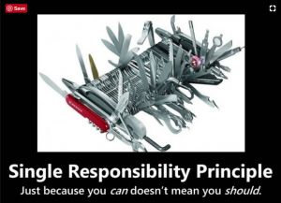
Single Responsibility Principle (SRP)
Single responsibility principle has one guiding principle
A class should have one and only reason to change.

Slide 7
Single Responsibility Principle ConT.
When designing a program, one class is at most responsible for one task or responsibility. And only when there is a change needed for that particular task should this class be changed.
Advantaged of SRP
Well organized code
Less fragile
Low coupling / High cohesion
Maintainability
Testability
Easier Debugging

Slide 8
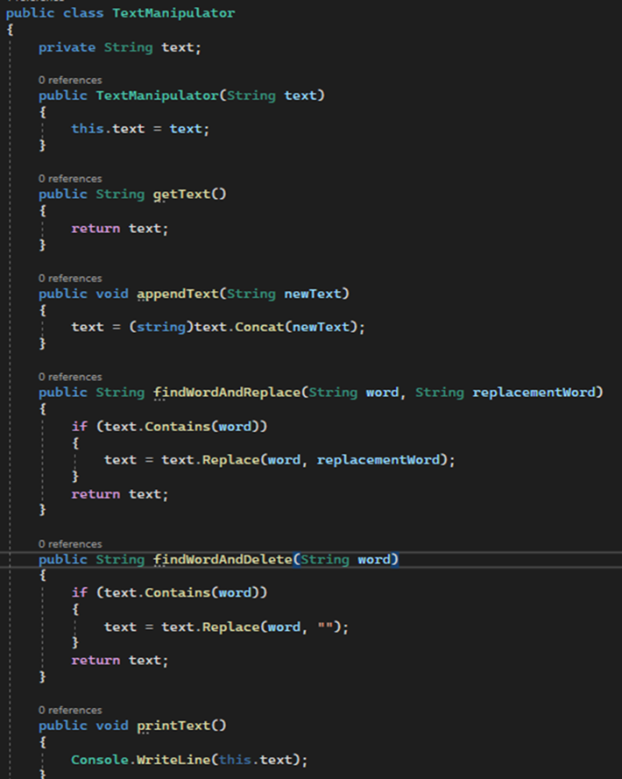
Violation of SRP
Where does this program violate SPR?
How can we improve the code so that the program is in accordance with the principle?
$1B

Slide 9
What problem have we noticed.
Multiple Responsibilities assigned to a single class.
The text manipulator class has text manipulation and print logic contained in it. Therefore, single responsibility principle has been violated.
Lacks cohesion of functionality.
Cohesion refers to the degree to which the elements inside a module belong together
The print function isn’t making modification to the text it’s just printing it. Therefore, does not belong in the class.
What should be done to fix the program in accordance with SPR?
Decouple the text manipulation and print logic (make a class for a print logic).
This will also allow us to expand more on the print functionality too.

Slide 10
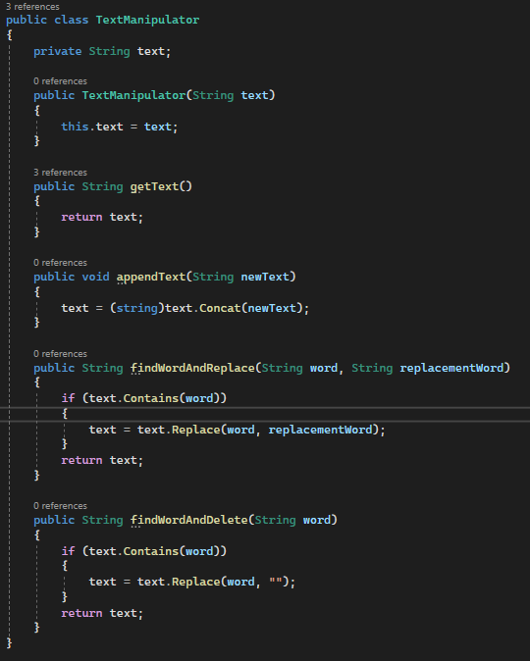
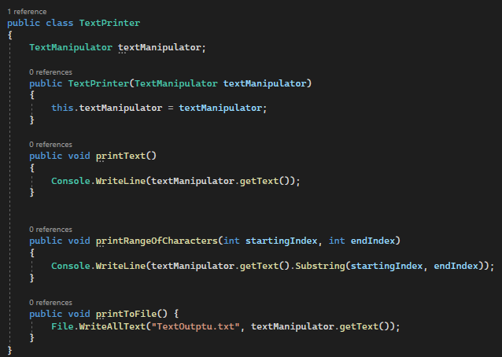
Proper implementation

Slide 11
Open-closed principle (OCP)
Guiding principle for OPC:
As the name suggests, this principle states that software entities such as: class, modules and function should be open for extension but closed for modification. As a result, when the business requirements change then the entity can be extended, but not modified.
Why not modify existing Code?
This is because modifying an existing code come with a risk of cratering bug.
How can we add functionality without modifying an existing class?
This is done with the use of delegate function, interface and abstract class.

Slide 12
OCP cont.
What are the advantages of Open-Close principle?
Better abstraction
Loosely coupled implementation
Easier debugging and testing
An already tested and deployed code won’t crush because it is not being modified.

Slide 13
OCP example
Suppose we are contacted by a client and were asked to write a program that calculate the accumulative area of a rectangle.
How we implement it?

Slide 14
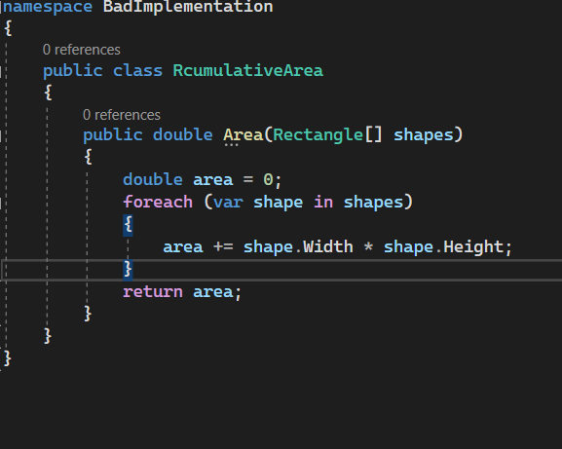
Bad implementation
The following implementation works fine. However, it is not an ideal implementation.
It is a good engineering practice to always keep in mind requirements could change and extension of functionalities are possible. Therefore, we need to keep our implementation open for extension.
Suppose our client contacted us again and requested for circle to be included in the functionality.
How we got about including circle in the program?

Slide 15
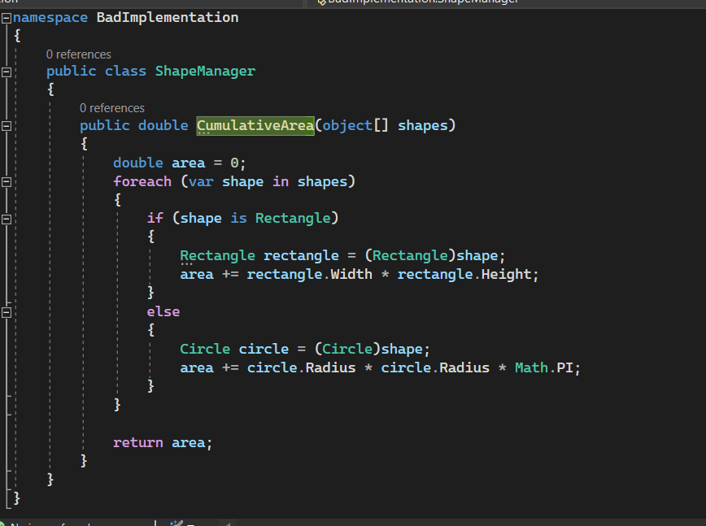
Bad implementation COnT…..
One way to go about it is to include a conditional statement takes the new requirement into consideration.
However, this is not a good practice.
As we take many more shapes into consideration, we will have to add more conditional statement resulting undesirable implementation.
ShapeManager isn’t closed for modification as we need to change it in order to extend it. Or in other words: it isn’t open for extension.
Makes the overall program difficult to maintain.
Makes testing difficult.
How can we improve?
Use abstract class.

Slide 16
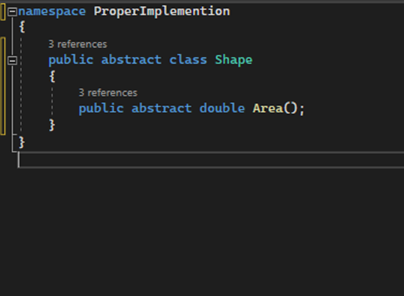
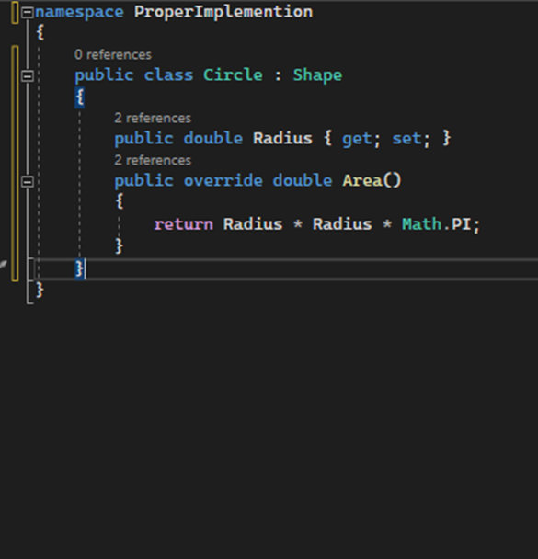
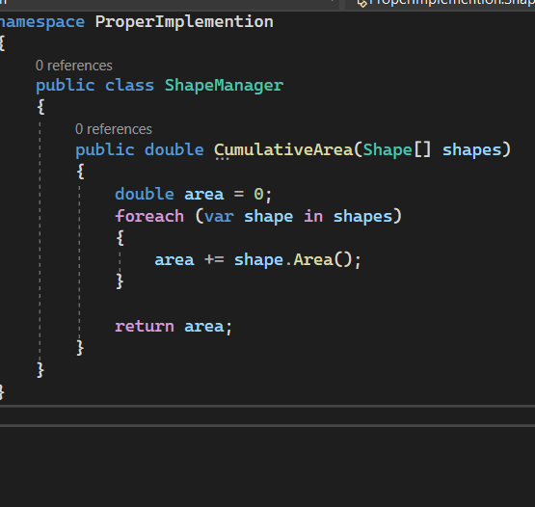
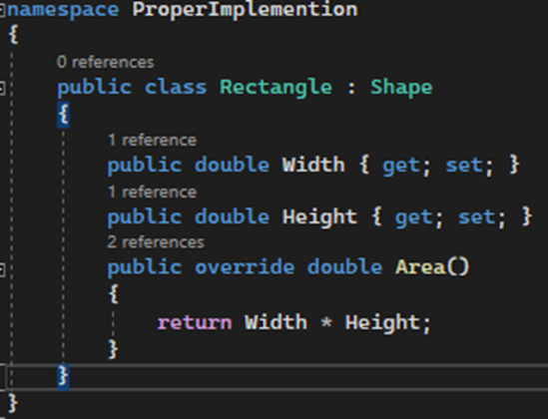
Compiling with OCP

Slide 17
Liskov substitution principle (LSP)
Liskov Substitution Principle states that subclasses should be substitutable for their base classes.
Given that class B is a subclass of class A, we should be able to pass an object of class B to any method that expects an object of class A, and the method should function without any error.
This means a subclass should inherit all the characteristics of its parent class and never disregard or downsize any property of the parent class.
A substitution should not result in an error.

Slide 18
LSP Benefits
Helps us model a good inheritance hierarchies.
Helps us prevent model hierarchies that don’t comply with the open-close principles.
Loosely dependent implementation.

Slide 19
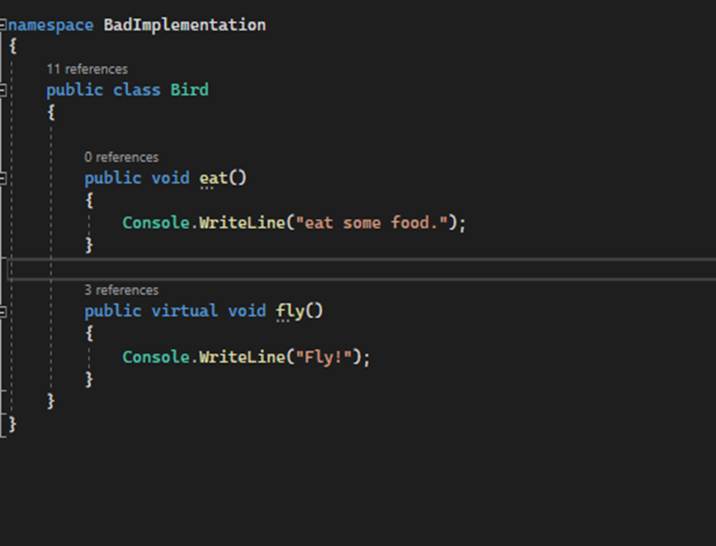
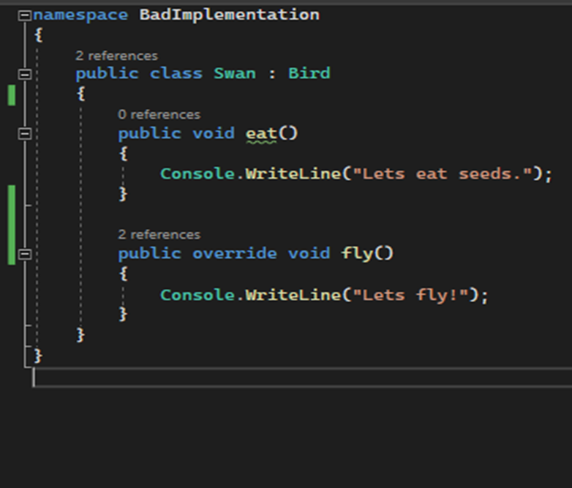
LsP Example

Slide 20
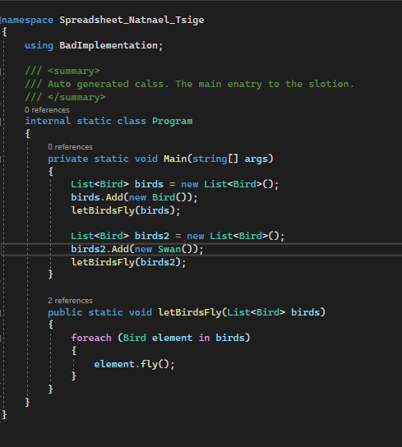
LSP Example Demo
In this case the inheritance will be successful.
What will the output to this be?
Fly
Let's fly!
What if we wanted implemented a bird that can’t fly. I.e., Penguin.
$1B

Slide 21
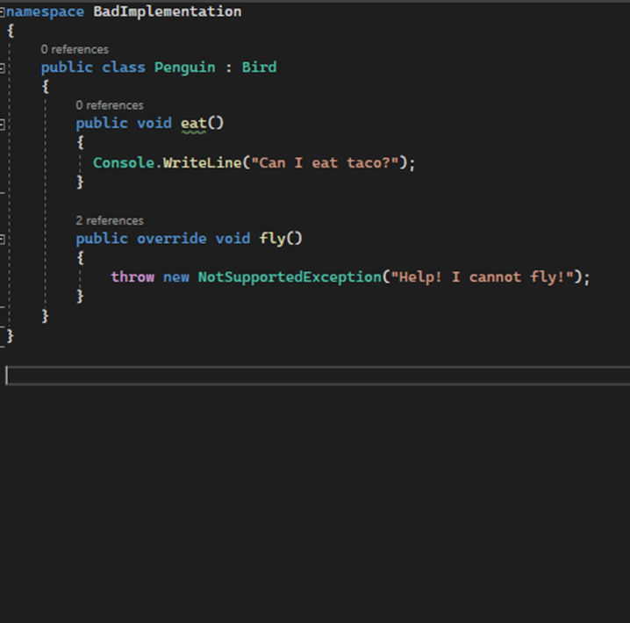
LsP Example Cont.

Slide 22
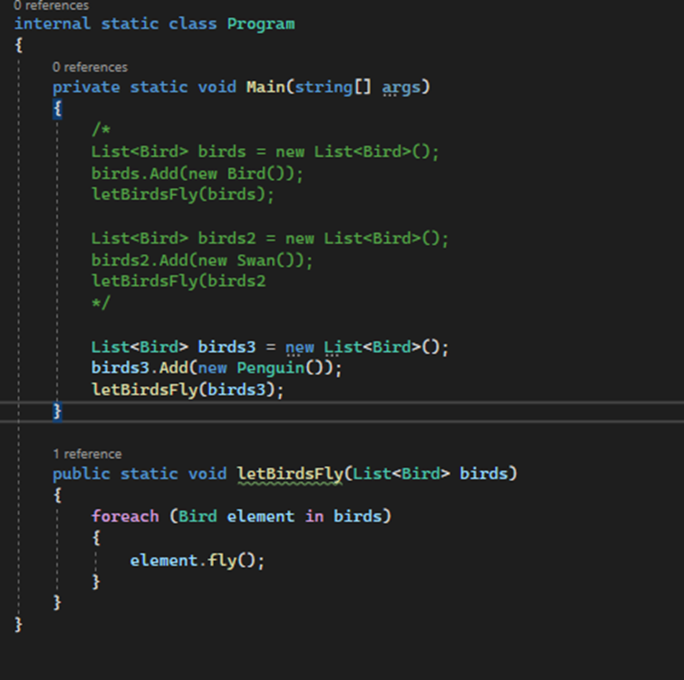
LSP Example Demo
This will violet LSP principle as it will throw an exception because Penguin can’t fly.
How would we go about fixing it?
$1B

Slide 23
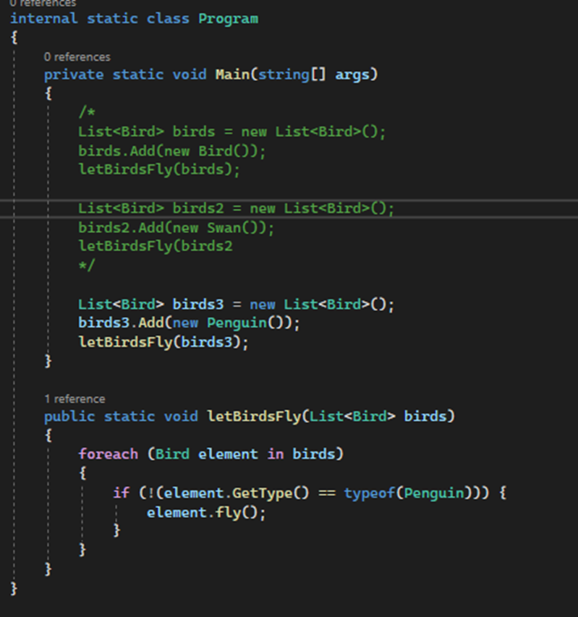
LPS Example cont ….
Of course, we can filter out nonflying bird, but this still doesn't address the problem as the substitution still throws an exception.

Slide 24
What problems have we observe?
The penguin class downsize the functionality of the bird class.
This is a direct violation of the LSP.
It also breaks the open-closed principle
What if we added multiple birds that can not fly?
How we can we refactor the program so that we can avoid the misbehavior of non-flying birds?

Slide 25
In class exercise.
Refactor the program such that it operates in accordance with LSP.
Hint:
Think of the single responsibility principle.
Where do we have multiple responsibilities assigned to a single class?
How would we decouple those responsibilities?

Slide 26
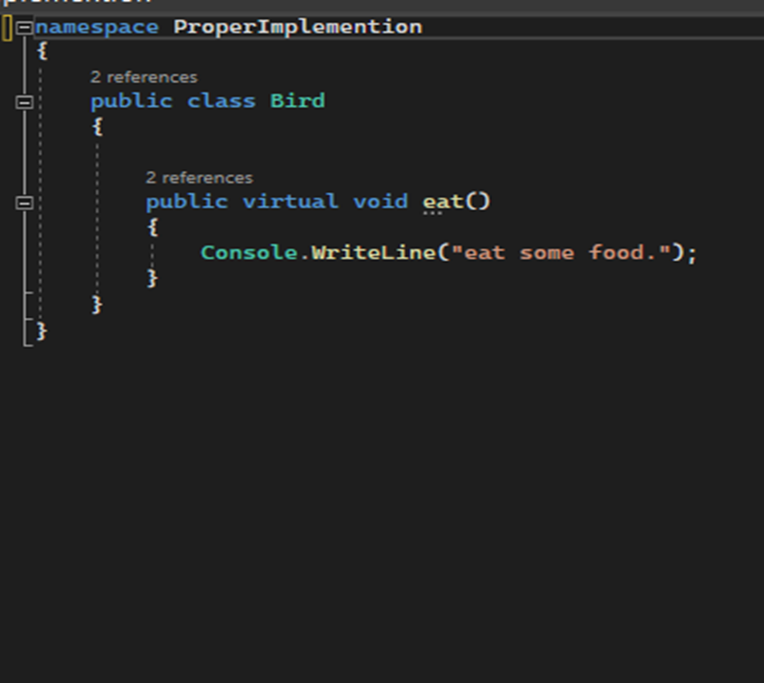
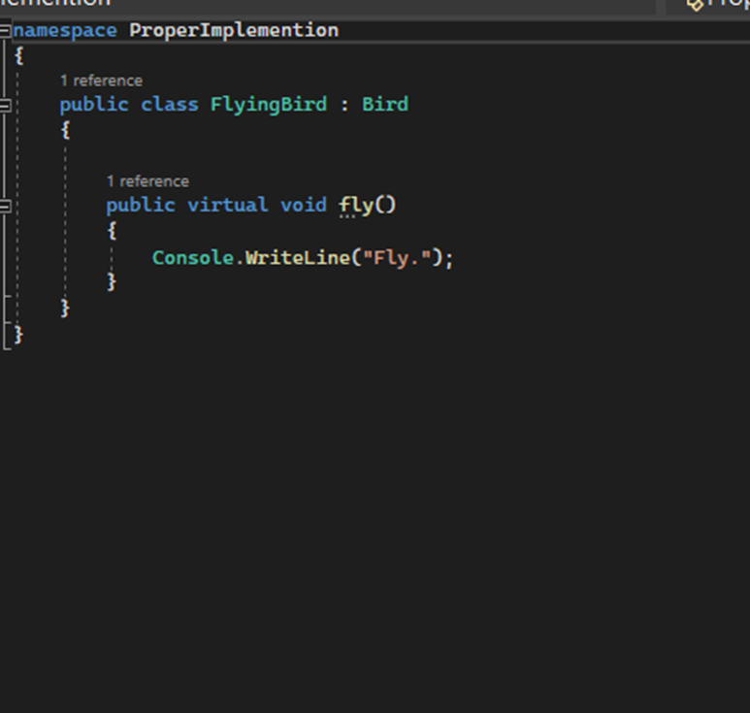
LSP complaint implementation

Slide 27
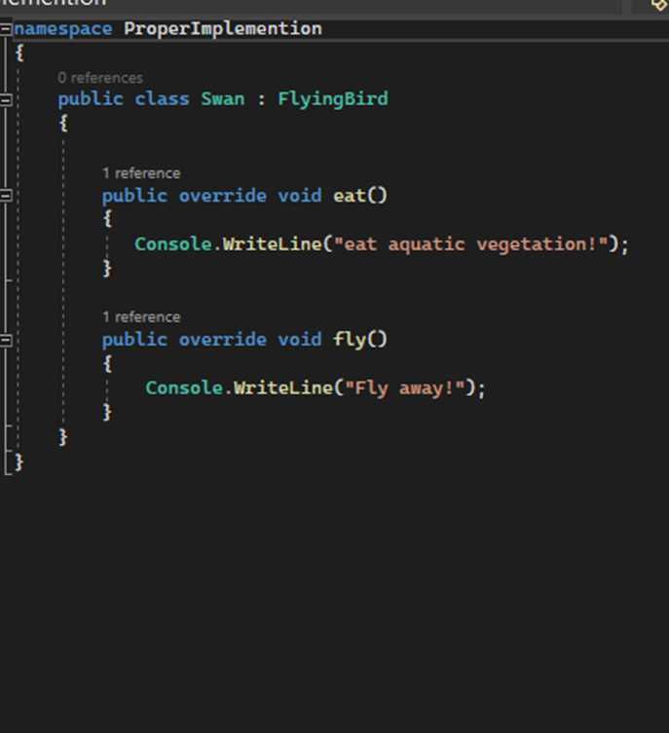
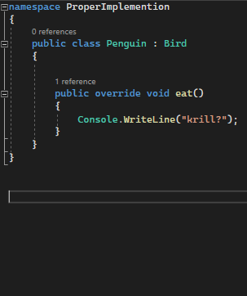
LSP Example Demo
$1B

Slide 28
In-class exercise
Refactor the Car.cs in the exercise solution.

Slide 29
Questions?

Slide 30
THANK YOU

